Slide 1




JADS MKBdatalab MasterSClass
Intro to
Danielle Paes Barretto

Slide 2
Overview
Power BI Features
Power BI Interface
Loading Data
Transforming Data (Power Query Editor)
Intro to DAX (New measure, Quick Measure)
Visualization (types, hierarchies, drill-down paths, sorting, filtering, controlling interactivity)

Slide 3
Time schema
13:00 – 15:00 – Intro to Power BI (Part 1 of 2)
15:00 – 15:30 – Break
15:30 – 17:00 – Intro to Power BI (Part 2 of 2)

Slide 4
Download and Install Power BI desktop
Download Power BI desktop
https://aka.ms/pbidesktopstore
Sign in to Power BI service
Before you can sign in to Power BI, you'll need an account. To get a free trial, go to app.powerbi.com and sign up with your email address.
For detailed steps on setting up an account, see Sign in to Power BI service.
IMPORTANT : If you use Mac refer to Power-BI-Manual in the repository to make possible using Power BI.

Slide 5
Power BI versions
Power BI Desktop | Power Service | Power BI Pro
Desktop | Cloud | More options of sharing
Data Analysis | Some report editing capabilities | Mobile App
Create Report | Create dashboards | Collaborate with other Power BI users
Free | Share and distribute reports
We will use the free version:
https://www.microsoft.com/en-us/download/details.aspx?id=58494

Slide 6
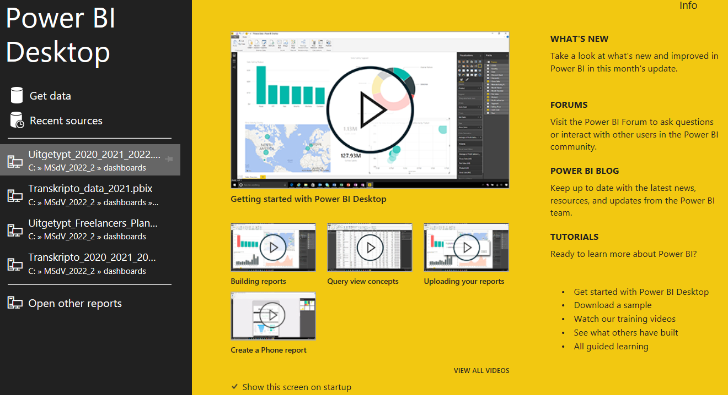
Power BI Interface

Slide 7
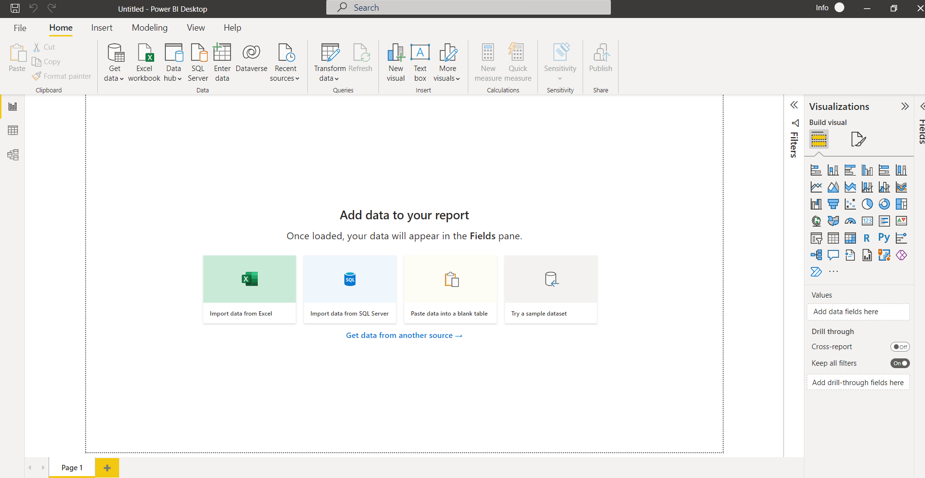
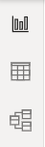
Power BI Interfaces (Views)
Report View
Data View
Model View

Slide 8
Dataset
AdventureWorks DW Scripts Zip
We will use a subset:
FactInternSale
DimCustomer
DimDate
DimProduct
DimProductCategory
DimProductSubCategory
DimSalesTerritory

Slide 9
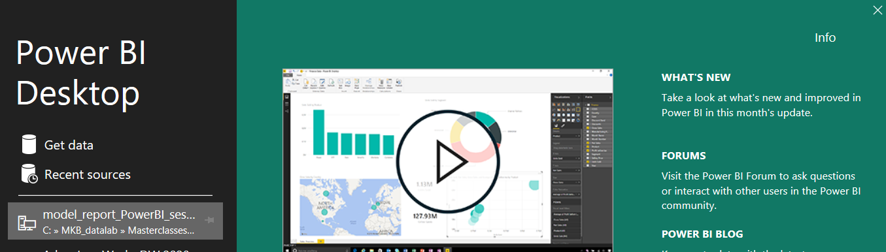
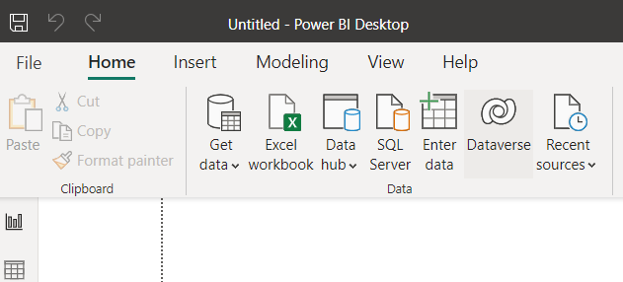
Loading Data
Notes:
I’ve chosen to “Never detect column types and headers for unstructured sources’ from File > Options and Settings > GLOBAL > Data Load so we need to do it manually.

Slide 10
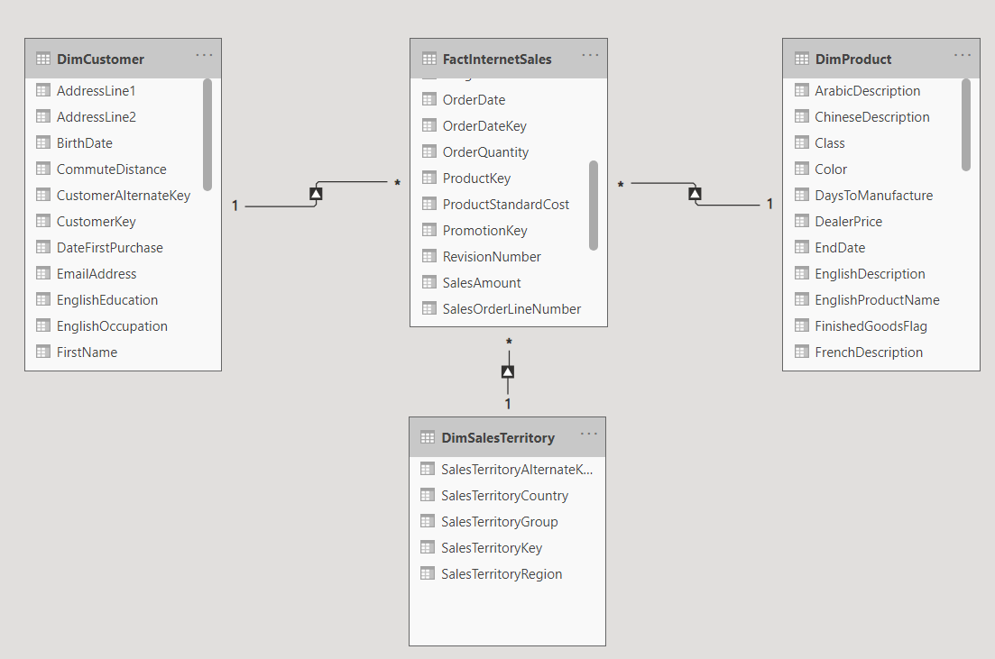
STAR schema
Fact table: Events & Transactions
Dimension Tables: More info about each transaction in Fact Table
Notes:
Power BI is designed to work with a common database structure known as ‘start schema’. For instances, the database we will work on AdventureWorksDW. https://learn.microsoft.com/en-gb/dax/dax-sample-model

Slide 11
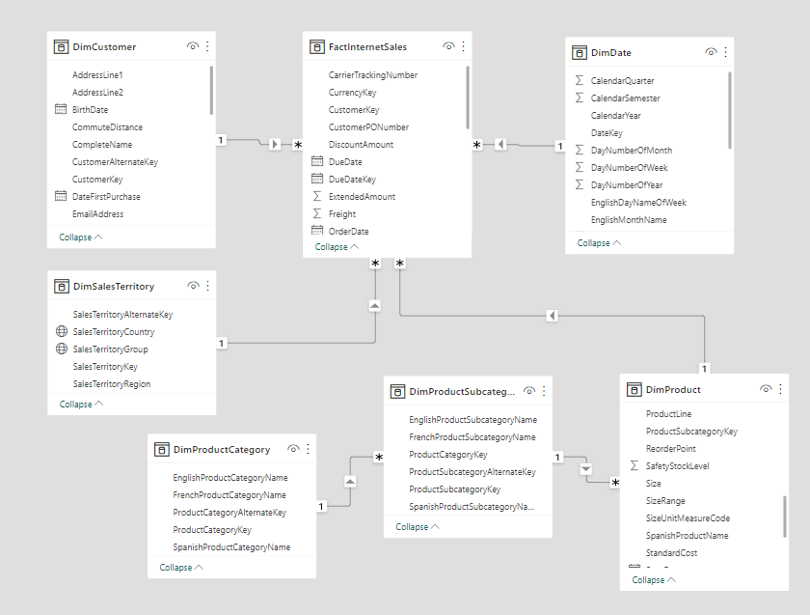
Our dataset (Complete Model view)
Notes:
Notice the keys and connections (e.g. CustomerKey, ProductSubcategoryKey, ProductCategoryKey, SalesTerritoryKey, DateKey)
Make relationships
Primary x Foreign key
Star structure
Comment on relationships
Automatic vs Manual connection of keys

Slide 12
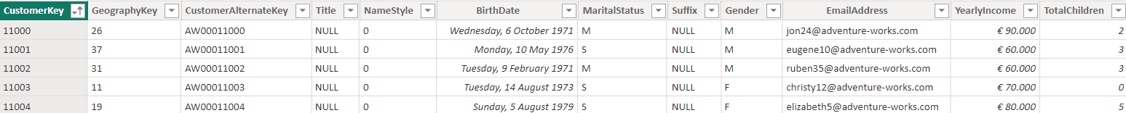
Relational Databases
Relational databases contain tables that are related with each other
In each table:
Columns -> fields
Rows -> records
A unique identifier of a record is called Key
Having more tables, each with a clearly marked subject, is generally better than having fewer tables where information about multiple subjects is combined.
We can always use SQL to gather information from multiple related tables and connect them if a question requires it, but table topics should remain separate.

Slide 13
Foreign and Primary Key
A foreign key is a column that references a single, specific row in the database
Foreign keys reference other rows using a unique identifier for the row.
The unique ID often comes from a primary key column in the referenced table.
Primary keys are specially designated columns where each row has a unique, non-null value.
Foreign key columns are restricted to contain either a value that is in the referenced column, or null. If the value is null, it indicates that there's no relationship for that row.

Slide 14
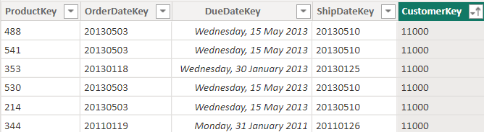
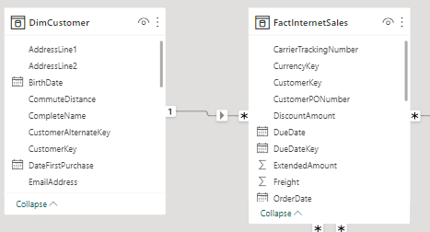
Example Foreign and Primary Key
A foreign key is a column or a set of columns in one table that references the primary key columns in another table.
FactInternetSales
Column CustomerKey of FactInternet Sales is a Foreign Key referencing the DimCustomer table.
DimCustomer
Column CustomerKey is the Primary Key the DimCustomer table.
Notes:
Notice many-to-one relationship between FactInternetSales and DimCustomer

Slide 15
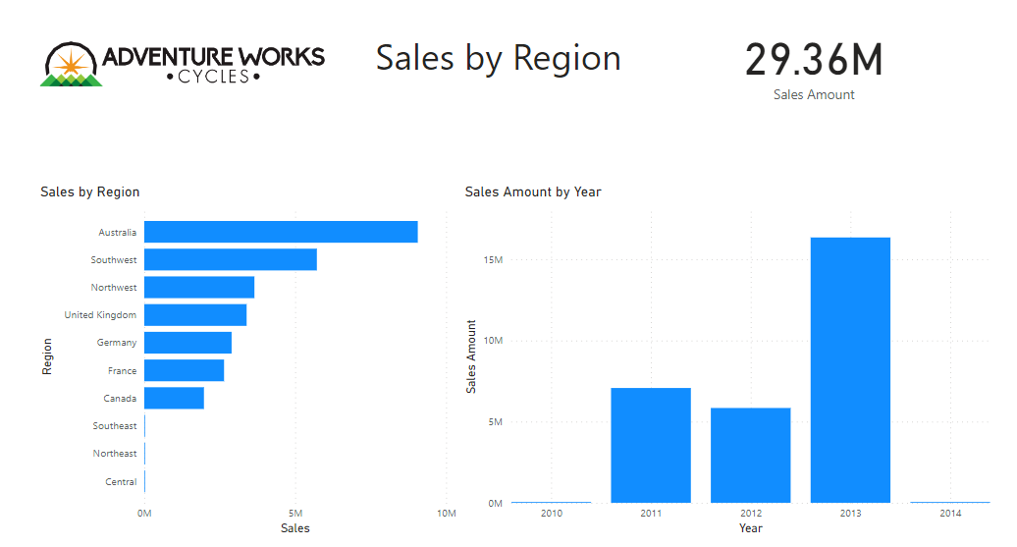
Warm Up

Slide 16
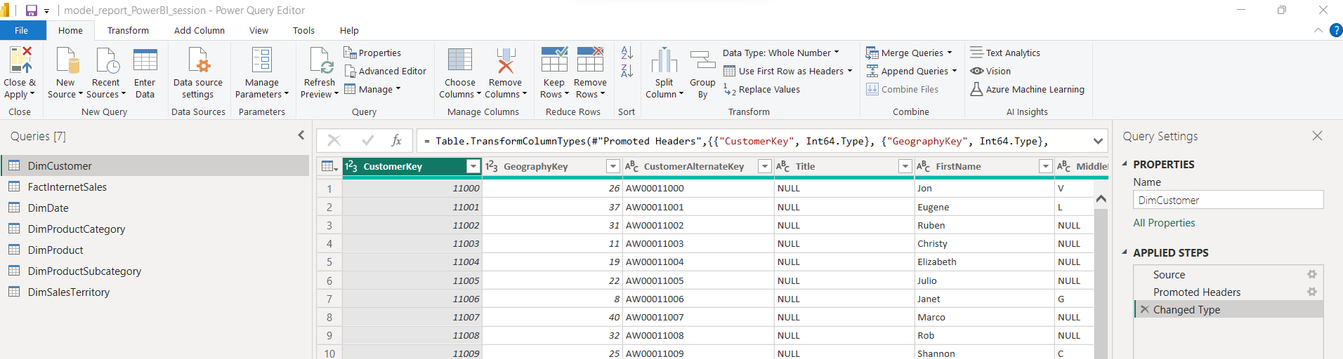
Transforming Data
Notes:
You can transform data both in Power Query (icon Transform data) or in Data View. In Power Query the original data is affected, in Data View the transformation serves only for visualization purposes.
Not all transformations can be performed in Data View (for instances, Group By)
Let’s explore a bit what can be done in Power Query…
Some examples:
Use first row as header
Remove columns
Change data type
Create columns
Replace , etc

Slide 17
Let’s apply some data transformation

Slide 18
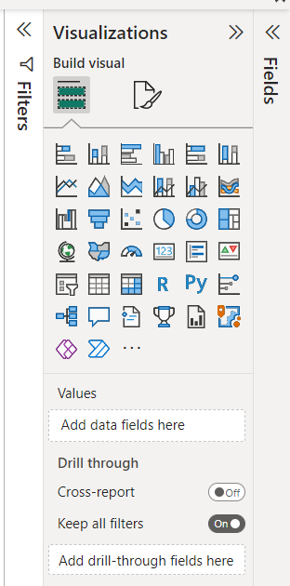
Building Visualizations
Column and bar charts
Line charts
Area Charts
Pie and donut charts
Tree Maps
Card and Multi-row card
Gauge and KPI
Table and Matrix
… Extra visuals can be obtained.

Slide 19
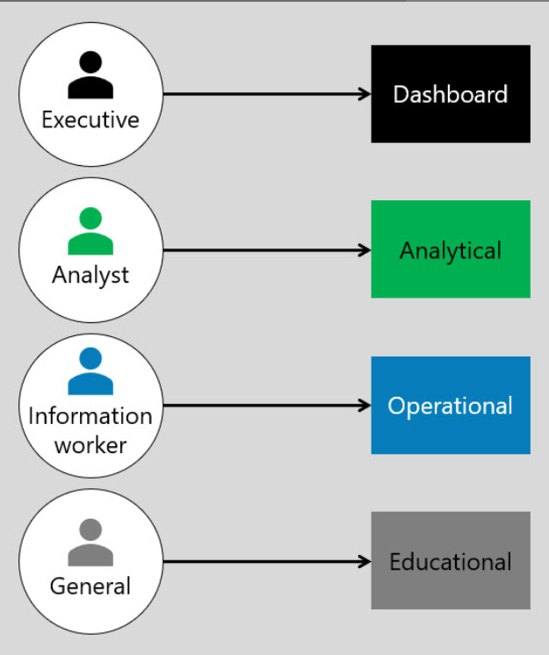
Report Tips
Consider your audience when building content and designing how to present it!
"How are we doing?"
"Are we there yet?"
"Why did that happen?"
"What might happen next?"
"What’s happening now?"
And allows immediate action (action button).
Assumes that the consumer is unfamiliar with the data or context. (E.g. Corona report, MKBs)
Notes:
When talking with MKBs, for example, don’t use the same language you use with your friends data scientists. Show how data can help the business and solve their problems in a practical way.
Source: Determine report types - Training | Microsoft Learn

Slide 20
Visualizations Tips
Focus on one story per report page
Be consistent with colors
Don’t use too many colors
Consider color blindness (4% of the population has some kind of color blindness)
Use meaningful and not too long name for axis
Title your visuals in a meaningful and clear way
It is often best to draw lots of simpler plots that each answer a couple of questions, rather than trying to draw a single plot that answers everything.
Choose an effective visualization
Visual Analysis Best Practices: A Guidebook
How to Choose Colors for Your Data Visualizations

Slide 21
Time for hands-on!

Slide 22
DAX
Data Analysis Expression
Based on excel formulas and functions (e.g. SUM())
Formula language to create tables, columns and measures
Function categories
Aggregation - SUM() , AVERAGE() , COUNT()
Date and Time - TODAY() , MONTH() , YEAR()
Logical - IF() , AND() , OR()
Text - CONCATENATE() , UPPER() , LEFT()
And many more..
DAX function reference - DAX | Microsoft Learn

Slide 23
DAX
Calculated Columns | Calculated measure
Expands existing data without editing the source data. | Aggregates multiple rows (e.g. count of distinct customers (e.g. DISTINCTCOUNT(CustomersActivity[CustomerKey]))
Evaluates at row level and adds new column to a table (e.g. Profit = Revenue – Cost, where Revenue and Costs are columns of a table). | Evaluated in the set of data selected (i.e., filters and slicers applied to the report).
Calculated when loading data or refreshing. | Not stored in memory. It is calculated as you interact and filter.

Slide 24
DAX’s date and time intelligence functions
In the data we use there is already a stand alone date table but this is not always the case.
A dedicated date table in your model is highly recommended for accurate reporting, particularly if you'll be using time-intelligence functions.
Applying a time intelligence function on a date table with gaps will not return an error but will provide a wrong result!
The benefits of a dedicated date table includes :
filtering across multiple date attributes such as Month and Year.
Creating custom calendar views and definitions to match your financial year.
Using time-intelligence features to select a time horizon such as Last 30 Days.
Applying this to many types of analysis including revenue by day of week, fiscal and public holiday performance.
Date and time functions

Slide 25
Some more hands-on…

Slide 26
Some more links…
Scope report design requirements - Training | Microsoft Learn
https://learn.microsoft.com/en-us/power-bi/transform-model/desktop-quick-measures
https://learn.microsoft.com/en-us/powerquery-m/

Slide 27
Questions? Comments?

Slide 28

Thanks!
www.jadsmkbdatalab.nl
d.paes.barretto@tue.nl
MKB Knowledge Repository

